Slide 1


ADHIPARASAKTHI ENGINEERING COLLEGE MELMARUVATHUR – 603 319 (DEPARTMENT OF COMPUTER SCIENCE AND ENGINEERING)
OM SAKTHI
AUTHENTICATION TOOL FOR RANSOMWARE PREVENTION AND MITIGATION IN ORGANISATION BY USING MFA
SUBMITTED BY
DILLIKUMAR N (420420104010)
HARISH N (420420104016)
KARTHIKEYAN A (420420104025)
CHANDRASEKARAN S (420420104301)
GUIDED BY
Mr. G. SEKAR
AP/CSE

Slide 2
INTRODUCTION
Modern computer systems often hold information which is of significant value to competitors, foreign/national states or criminal actors.
As these systems become increasingly connected, the threat of attack by adversaries increases.
As a result many enterprise networks have been, or currently are, under cyber attack. The market for security tools to help protect systems and identify attacks has grown significantly over recent years.

Slide 3
OBJECTIVE
This project aims to develop a tool that can detect ransomware in organizations.
Networks using a combination of signature-based, behavior-based, and deception-based techniques. The tool will monitor the network traffic, file system changes, and system events
To identify any suspicious or malicious activities that indicate a ransomware infection.

Slide 4
ABSTRACT
As organizations have embraced remote and hybrid working, employees are often using personal devices and less secure internet connections to access their organizations’ networks.
A compromised router can allow a hacker to install password-stealing malware on a user’s machine, and these attacks often go undetected until the hacker reaches the organization’s network and it becomes too late.
When using MFA to log in to their console, organizations no longer have to worry about the security of remote employee’s devices and other connections they have on Internet.

Slide 5
LITERATURE SURVEY
S.No | TITLE | STRENGTHS | WEAKNESSES
1. | Karim, Nader Abdel, Osama A. Khashan, Hasan Kanaker, Waleed K. Abdulraheem, Mohammad Alshinwan, and Abdulkarim Albanna. "Online Banking User Authentication Methods: A Systematic Literature Review." IEEE Access (2023). | Proposed a variety of MFA techniques against known Attacks to understand the robustness of the system | The system is inconsistence from Social Engineering attacks
2. | Zulkifl, Zeeshan, Fawad Khan, Shahzaib Tahir, Mehreen Afzal, Waseem Iqbal, Abdul Rehman, Saqib Saeed, and Abdullah M. Almuhaideb. "FBASHI: Fuzzy and blockchain-based adaptive security for healthcare IoTs." IEEE Access 10 (2022): 15644-15656. | The access is granted based on the least privilege | Weak authentication Security patterns and easy to break by brute force attack

Slide 6
LITERATURE SURVEY
S.No | TITLE | STRENGTHS | WEAKNESSES
3. | Sun, Nan, Ming Ding, Jiaojiao Jiang, Weikang Xu, Xiaoxing Mo, Yonghang Tai, and Jun Zhang. "Cyber threat intelligence mining for proactive cybersecurity defense: a survey and new perspectives." IEEE Communications Surveys & Tutorials (2023). | They well defined the delay incurred for fetching tickets from the Kerberos server and the for completion of the authentication process | This method needs to be well refined in the Security pattern in VPN.
4. | Chishti, Mohd Sameen, Chung-Ta King, and Amit Banerjee. "Exploring half-duplex communication of NFC read/write mode for secure multi-factor authentication." IEEE Access 9 (2021): 6344-6357. | Proposed MFA scheme against known Attacks to understand the robustness of the system | The system didn't support full duplex Communication
5. | Wang, Fan, Sen Zhang, and Yixin Yin. "Log likelihood monitoring for multimode process using variational Bayesian mixture factor analysis model." IEEE Access 7 (2019): 89083-89092. | Standardize it by utilizing the Mean and variance gotten in the first step of offline Modeling. | Process monitoring becomes difficult when The value is near the normal condition

Slide 7
PROBLEM STATEMENT
Organizations that have asserted confidential data suffer a lot from ransomware threats.
In general, as per need we connect a vpn from home it asks for two-factor authentication along with rsa and other configurations.
When it comes to the organization using a vpn and all that network doesn't ask for the mfa, these kinds of gaps in authentications may cause a high possibility of a ransomware attack

Slide 8
PROPOSED SYSTEM - (Subjective Based Questions)
To make an authentication by using Subjective Based Questions to the User in Order to Get reasource from site or Online Access as finanitial resources.
That Subject Based Questions performes in after the login into site by providing credentials and before action of resource getting from the site.
. Unlike objective questions that have clear-cut answers, subjective questions involve personal feelings, opinions, and interpretations.

Slide 9
FUNCTIONAL AND NON-FUNCTIONAL REQUIREMENTS
Functional Requirements:
The system must allow users to log in using their credentials (e.g., username and password). After successful login, the system should prompt users with subjective-based questions.
The system needs a mechanism to manage subjective questions. Users can able to set their own questions during registration.

Slide 10
Non-Functional Requirements:
The system must ensure the confidentiality of subjective answers. Strong encryption should protect user data during transmission and storage
The user interface should be intuitive and user-friendly. Subjective questions should be clear and easy to understand.
The system should respond quickly during login and question presentation.
Scalability is essential to handle a large number of users.

Slide 11
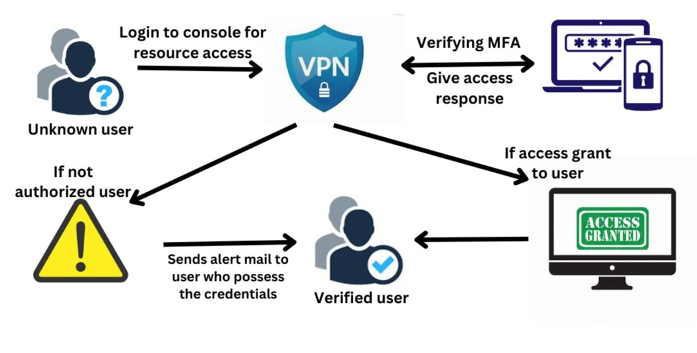
SYSTEM ARCHITECTURE FOR AUTHENTICATION TOOL

Slide 12
MODULE 1
PROJECT MODULES
System for includes authentication system which is one blog application for accessing authority of the account as a user.
MODULE 2
Multi Factor Authentication mechanism Using Knowledge Based Authentication (Subjective Based Questioning) method
MODULE 3
Implementing Ransomware Threat Detection by alerting user through smtp for the user .

Slide 13
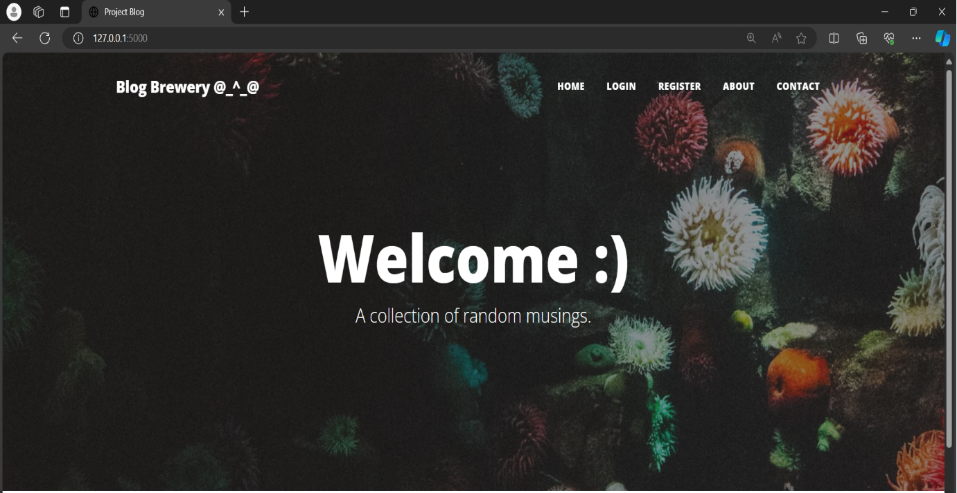
SNAPSHOTS

Slide 14
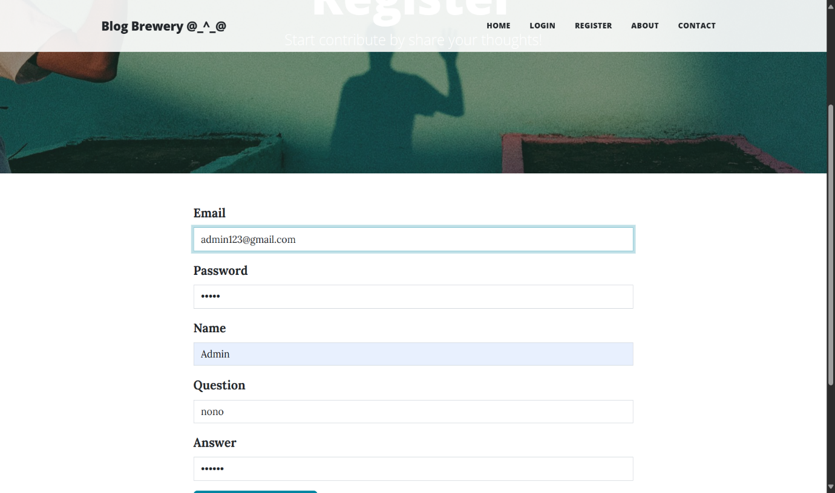
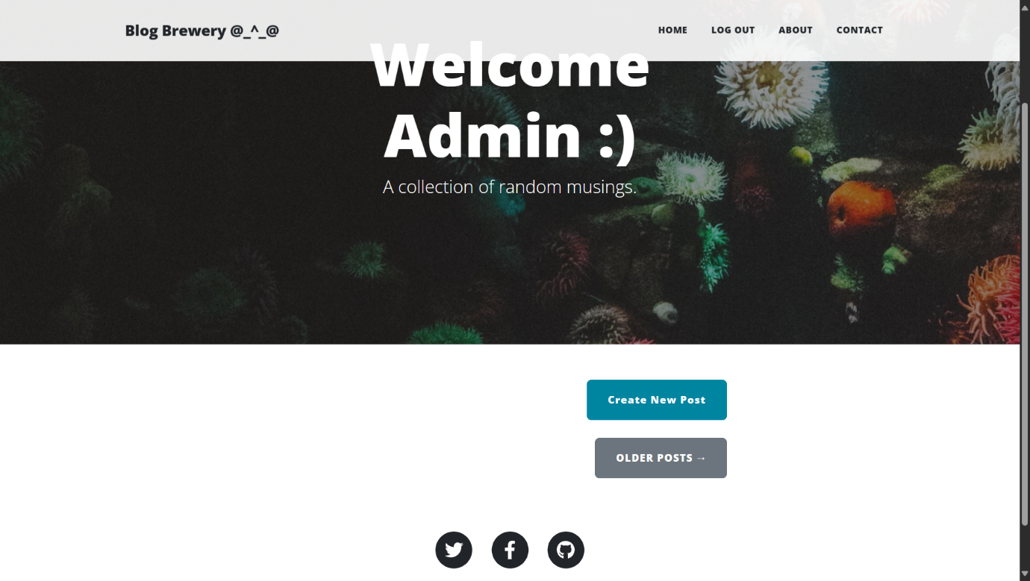

Slide 15
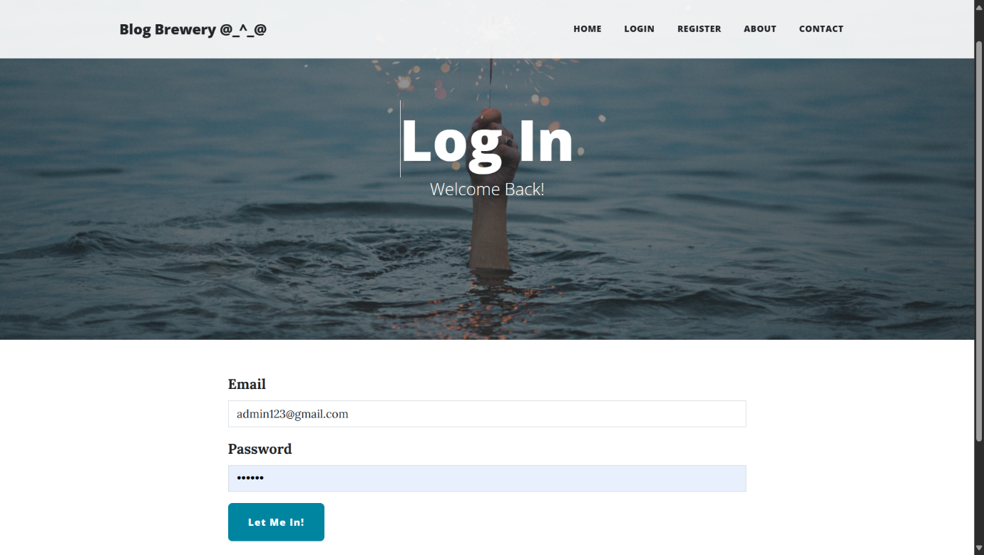
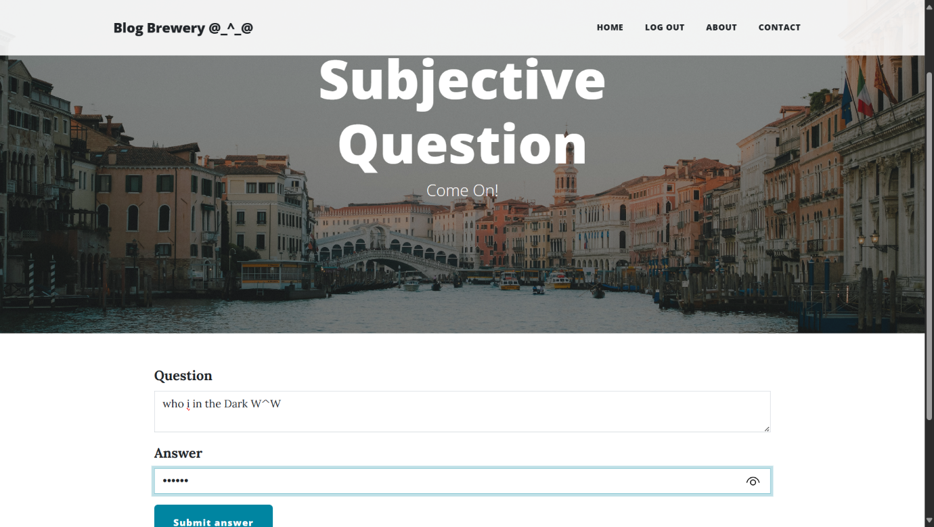

Slide 16
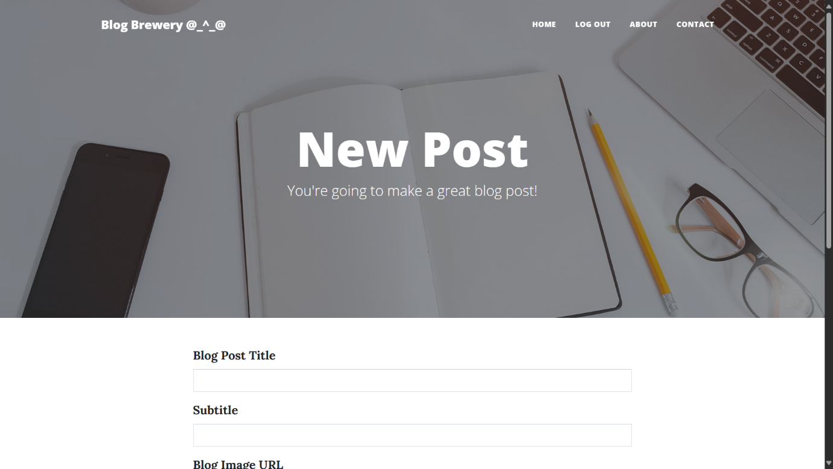

Slide 17
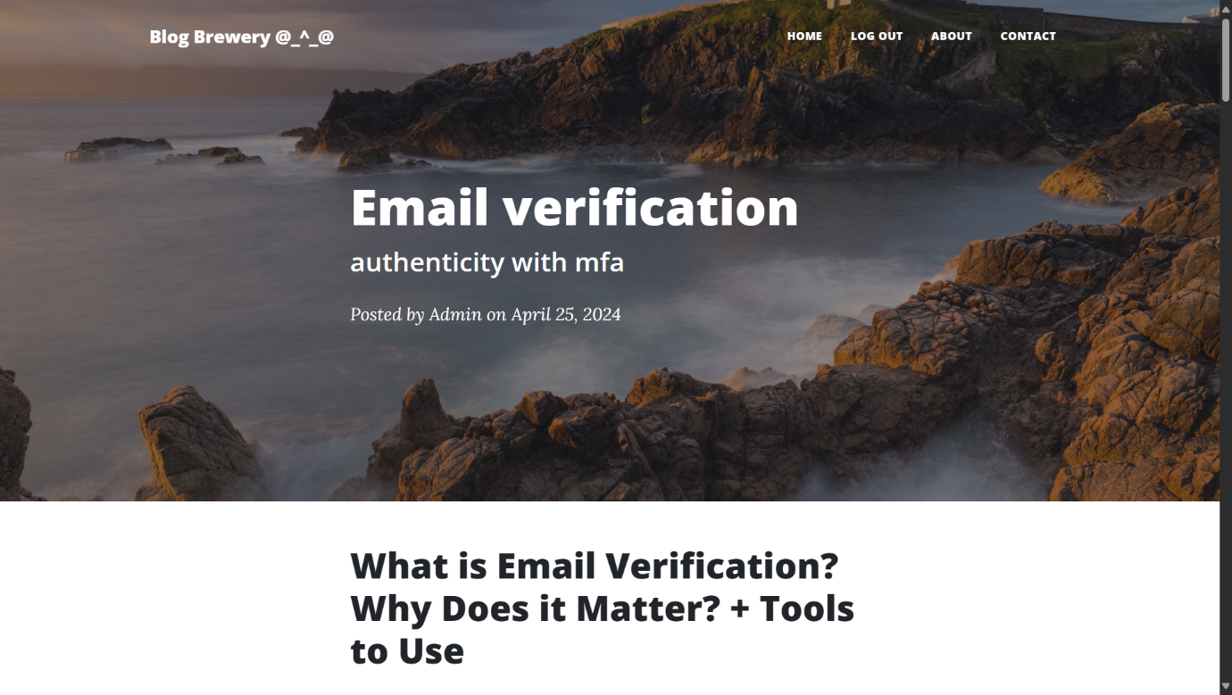
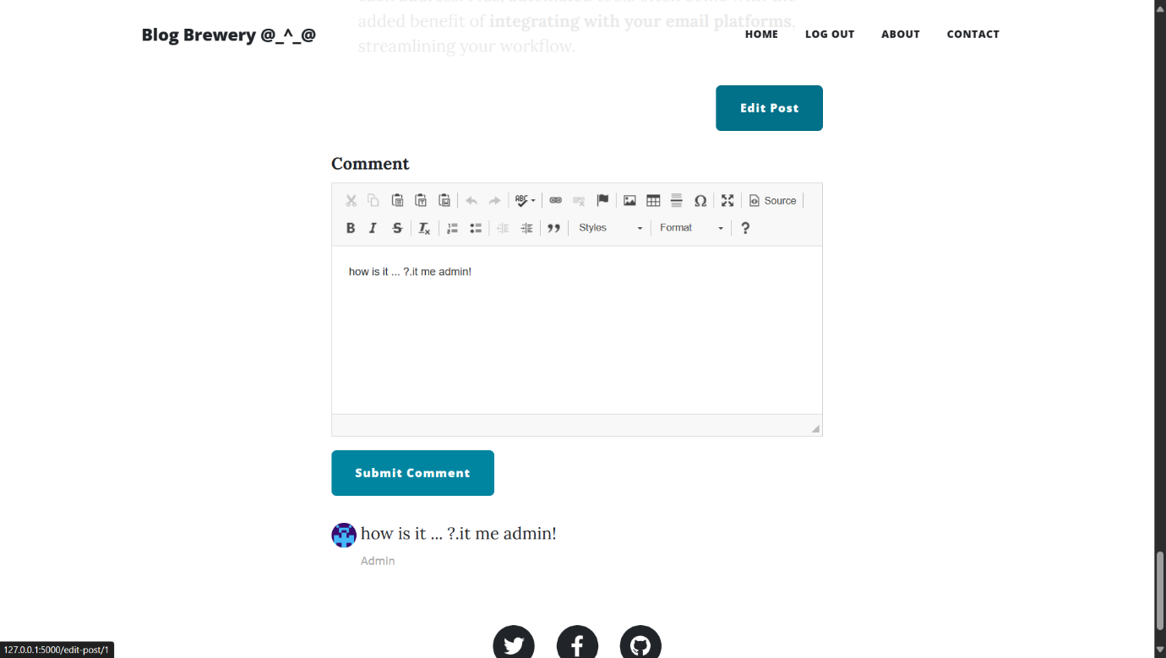

Slide 18
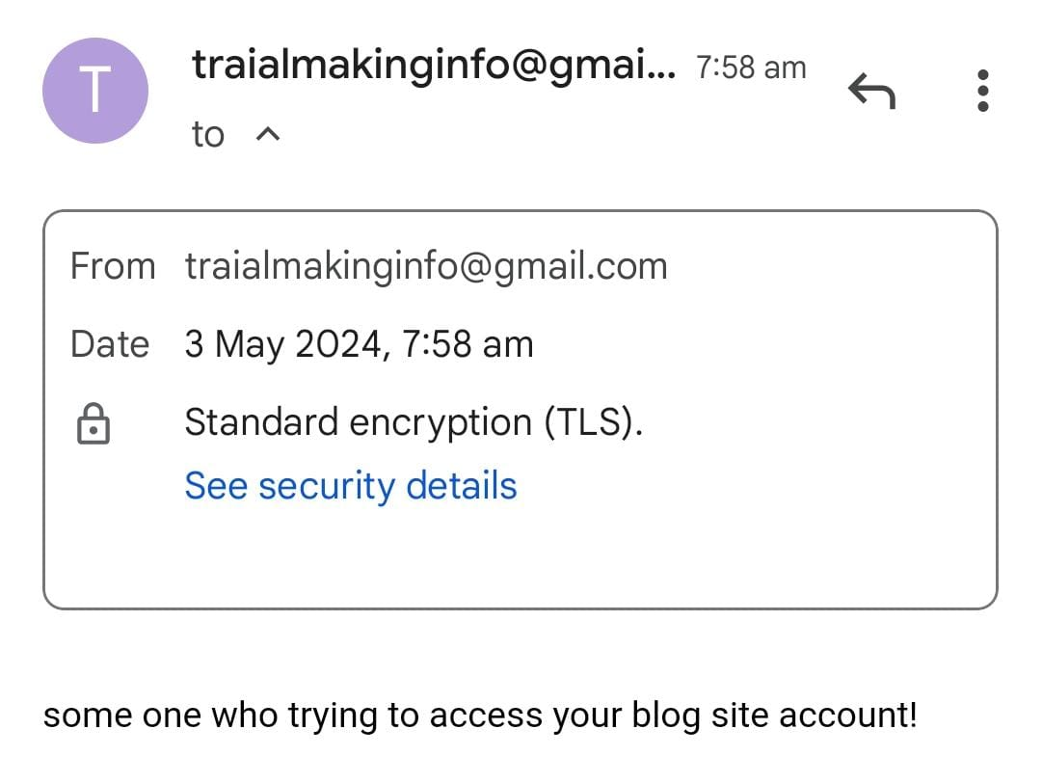

Slide 19
APPLICATIONS
Subjective-based questions provide an additional layer of security beyond traditional methods like passwords or knowledge-based authentication (KBA).
Subjective questions can be tailored to the user's preferences or context.
Subjective questions add an element of personalization to the authentication process.

Slide 20
CONCLUSION
In our innovative authentication system, subjective-based questions and answers getting as one of the method to authenticate users from diversity of systems which can be helpful for evolving technology.
Users select personalized questions related to their memories, preferences, or opinions.
These questions serve as unique authentication factors, enhancing security beyond and act as layer on the traditional methods.

Slide 21
FUTURE WORK
For Future enhancement we ‘ve planned for to do the User Experience better which is to be enhance and to pick up.
And make ready available for all end users from this project.
multi-factor authentication, and privacy enhancements will shape the future of this user-centric paradigm.

Slide 22
REFERENCES
[1]. P. C. Mondal, R. Deb and M. N. Huda, "Know your customer (KYC) based authentication method for financial services through the internet," 2016 19th International Conference on Computer and Information Technology (ICCIT), Dhaka, Bangladesh, pp. 535-540, 2016.
[2]. Z. Zulkifl et al., "FBASHI: Fuzzy and Blockchain-Based Adaptive Security for Healthcare IoTs," in IEEE Access, vol. 10, pp. 15644-15656, 2022.
[3]. J. Lee, J. Kim, I. Kim and K. Han, "Cyber Threat Detection Based on Artificial Neural Networks Using Event Profiles," in IEEE Access, vol. 7, pp. 165607-165626, 2019.
[4]. A. B. Ajmal, M. A. Shah, C. Maple, M. N. Asghar and S. U. Islam, "Offensive Security: Towards Proactive Threat Hunting via Adversary Emulation," in IEEE Access, vol. 9, pp. 126023-126033, 2021.

Slide 23
[5]. M. S. Chishti, C. -T. King and A. Banerjee, "Exploring Half-Duplex Communication of NFC Read/Write Mode for Secure Multi-Factor Authentication," in IEEE Access, vol. 9, pp. 6344-6357, 2021.
[6]. N. A. Karim, O. A. Khashan, H. Kanaker, W. K. Abdulraheem, M. Alshinwan and A. -K. Al-Banna, "Online Banking User Authentication Methods: A Systematic Literature Review," in IEEE Access, vol. 12, pp. 741-757, 2024.
[7]. O.B. Lawal, A. Ibitola, O.B. Longe, “Internet banking authentication methods in Nigeria Commercial Banks,” African Journal of Computing & ICT,Vol 6. No. 1, March 2013.

